Slide 1
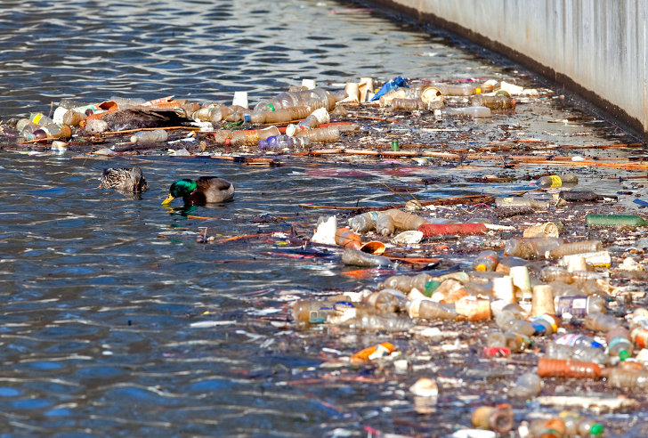
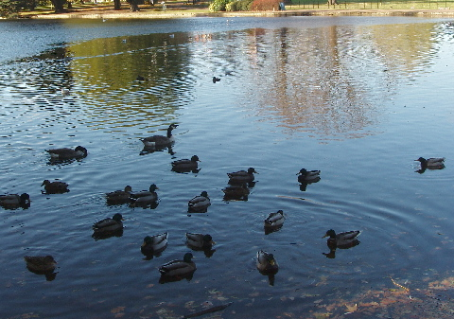
Solving the Problem
SS.7.C.2.12 Develop a plan to resolve a state or local problem by researching public policy alternatives, identifying appropriate government agencies to address the issue, and determining a course of action.
Steps for solving problems in your community!
Public Policy

Slide 2
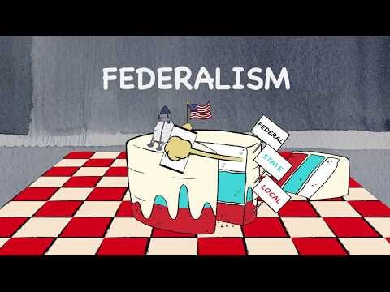
Levels of Government
Notes:
Click the image to view the Center on Congress’ video about Federalism.

Slide 3

Levels of Government
In our federal system of government, the government shares powers between three levels:
Government
Federal
State
Local

Slide 4
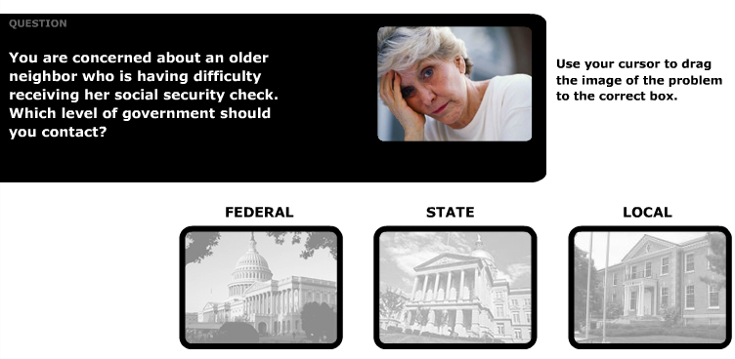
Where to Go with a problem
How do we know if a problem should be handled by local, state, or federal government?
Click the image to do an interactive activity!
Notes:
Once you click the image you will see an e-learning module titled “The Importance of Civic Participation”. Enter the module, and then select the “Where to Go With a Problem” module. This will provide scenarios that students then have to classify as local, state, and/or federal problems.

Slide 5
What problems exist in your community?
Make a list individually.
Next to each problem, decide which level of government would best solve it.
Write L for local, S for state, or F for federal next to each problem.
Notes:
While students are working on their lists of problems in their community, label 3 pieces of chart paper (or create 3 columns on the white board/smart board) “Local”, “State”, and “Federal”. When it comes time for the small groups to share their lists, work as a class to classify the problem into the correct level of government by writing them on the appropriate poster.

Slide 6
Levels of Government
In our federal system of government, the government shares powers between three levels:
Government
Federal
State
Local
Notes:
Classify the identified problems into appropriate levels of government.

Slide 7
Resolving Community Problems
Identify the problem.
What is the problem and who does it impact?
The problem is…………
Notes:
Review the steps needed for this problem-solving, project based model. First students need to identify problems in their community. Start with The problem is…..
Make sure students include evidence of why this is a problem and who it impacts.

Slide 8
Resolving Community Problems
Identify the problem.
What is the problem and who does it impact? The problem is….
Research public policy alternatives.
What are some ways this problem can be resolved using public policy?
Notes:
This research site within the National Conference of State Legislatures site may be helpful.
http://www.ncsl.org/research.aspx

Slide 9
Solving the Problem
It is important to investigate more than one way to solve a problem.
What are some ways your problem can be resolved using public policy?
Notes:
Have students identify 3 ways they could solve the problem they have identified using public policy (how is the government involved?) Students should then evaluate and rank their policies for effectiveness – which policy do they think is the most effective?

Slide 10
Resolving Community Problems
Identify the problem.
What is the problem and who does it impact?
Research public policy alternatives.
What are some ways this problem can be resolved?
Identify government agencies to address the problem.
Who would be responsible for resolving this problem?

Slide 11
Where would you Go?
You will be investigating the government agency (agencies) that would help implement public policy to resolve your problem.
Notes:
Web Quest: Using the lists your classes have created, divide up some of the problems from the local and state lists among pairs of students. Once students have been assigned a problem, they will write this into the appropriate space on their handout. Students should complete their handout by going online and finding the appropriate agency to contact on either the local or state level. A list of resources has been provided on their student handout to help guide their search. After completing the handout, students will create a poster based on the information they have learned about their agency including the issues they address and the people they serve. The following slides will give examples of agencies and where they might look for this information.

Slide 12
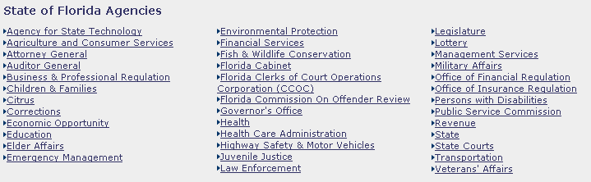
For example, for state-level problems:
The State of Florida has a directory of Florida Agencies:

Slide 13
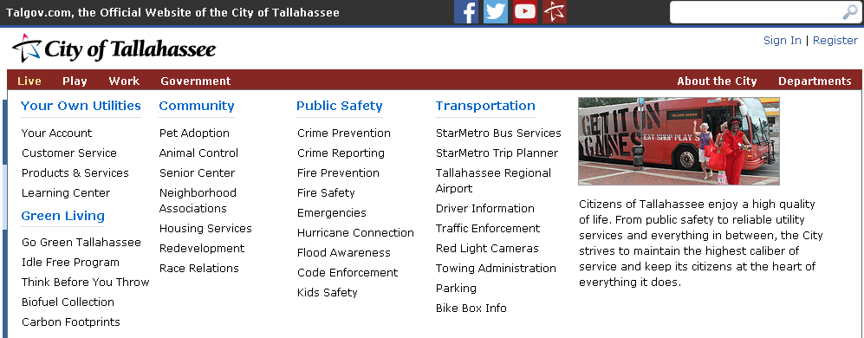
For example, for local problems:
Your city probably has a list of agencies where you can take problems.
For example, the city of Tallahassee has the following resources:
Notes:
What are your city’s agencies?

Slide 14
Identify the problem.
What is the problem and who does it impact?
Research public policy alternatives.
What are some ways this problem can be resolved?
Identify government agencies to address the problem.
Who would be responsible for resolving this problem?
Determine a course of action.
Who should we present our plan to and how can we make it a reality?
Notes:
Develop a plan to ensure your policy is presented to the appropriate source and can be adopted and implemented.

Slide 15
How do we solve problems in a community?
Public Policy Solutions
Community Service Solutions
How would you define public? (Government, the people as a whole)
How would you define policy? (Actions taken to solve problems)
So how would you define “public policy”? (What government does or does not do about a problem in society.)
How would you define community service?
Voluntary work intended to help people in a particular area or contribute to a particular cause.
How does community service differ from public policy solutions?
Notes:
Definition of public policy: simply what government (any public official who influences or determines public policy, including school officials, city council members, county supervisors, etc.) does or does not do about a problem that comes before them for consideration and possible action.
Teachers should review this link for background on public policy.
http://www.civiced.org/pc-program/instructional-component/public-policy

Slide 16
What is Public Policy?
On your handout, identify examples of public policy and examples of community service. Write “P” for Public Policy or “C” for Community Service.
As you do this, think of ways that the examples of public policy could be accomplished with community service. How could community service examples be made into public policy?
Notes:
Participants will then use the handout to identify and distinguish examples of public policy and community service. Discuss the difference between public policy and community service. Where public policy utilizes government to solve an issue, community service is when a group of individuals come together to independently solve an issue or address a community concern without government involvement. Community service can be voluntary work intended to assist with a cause or can also serve as part of a sentence/punsihment as a result of committing a crime.

Slide 17
What is Public Policy?
Public Policy
Community Service or Service Learning
Local government installs trash cans; fines for littering enforced
School board ban on student cell phones because of cheating on tests
Local government funds homeless shelter and materials
City fee to aid with road repairs
Local government funds bicycle safety classes
Volunteer to pick up trash
Offer peer tutoring for test prep
Elks Club collecting items for the homeless
Soccer team holds fundraiser to repair the road
Local cycling group holds bicycle safety classes for the community
Notes:
Debrief the handout by asking participants if the examples described are examples of public policy or community service. Upon answering, ask them how the example could be made a public policy or how the example could be community service. Possible answers are provided on the presentation.

Slide 18


Answer the question below:

